Slide 1

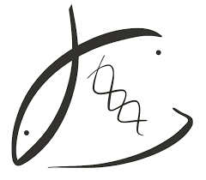


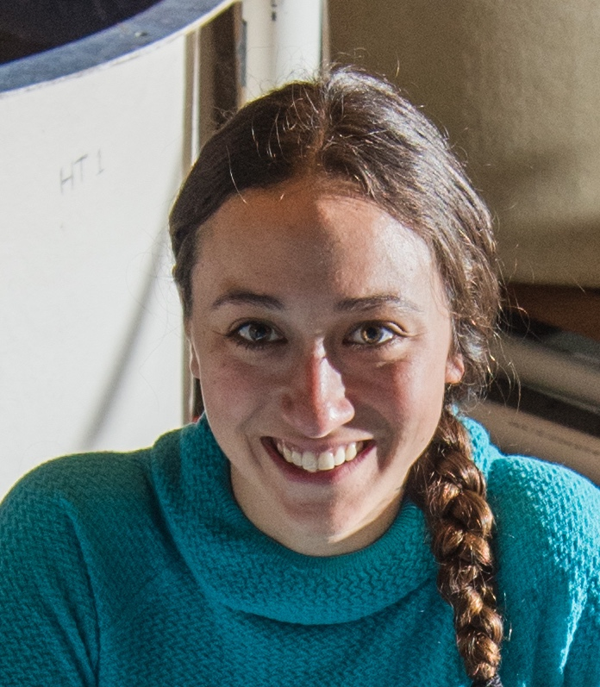
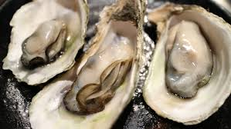
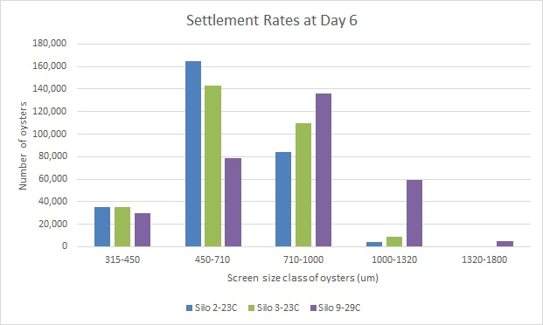
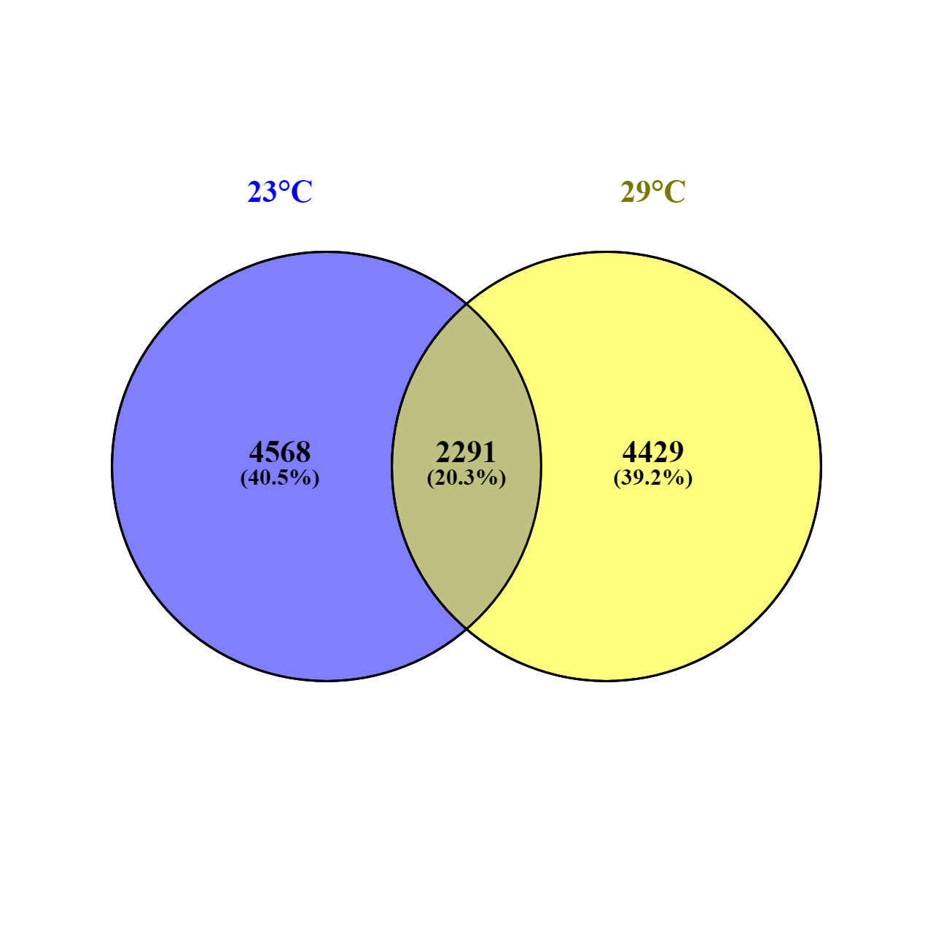
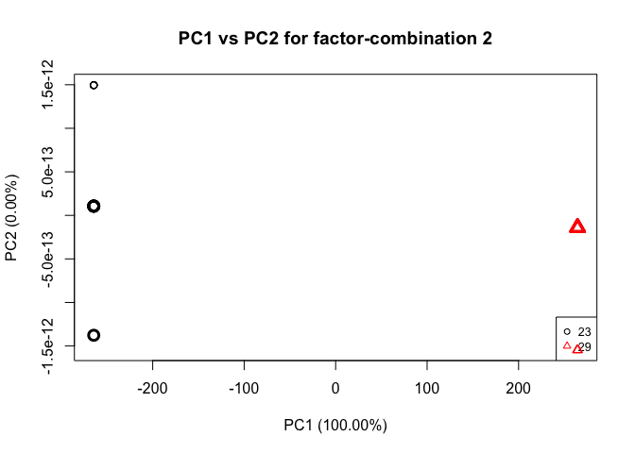
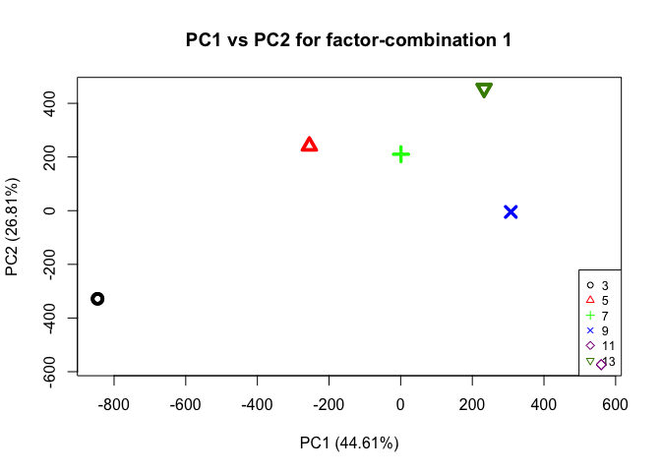
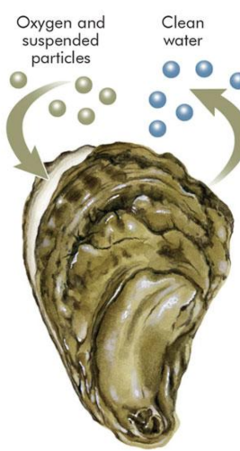
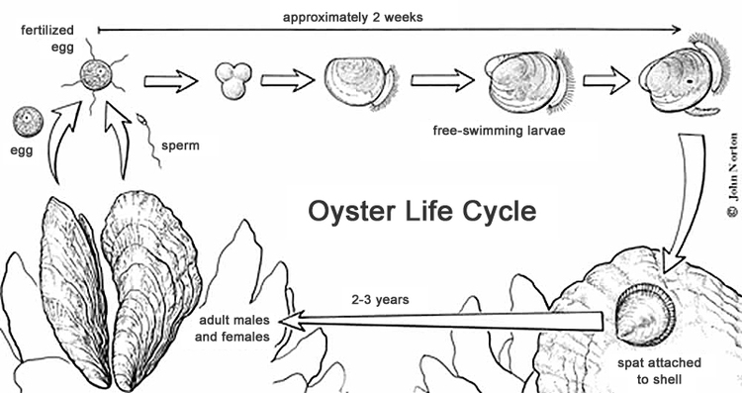
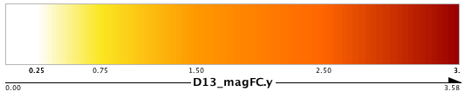
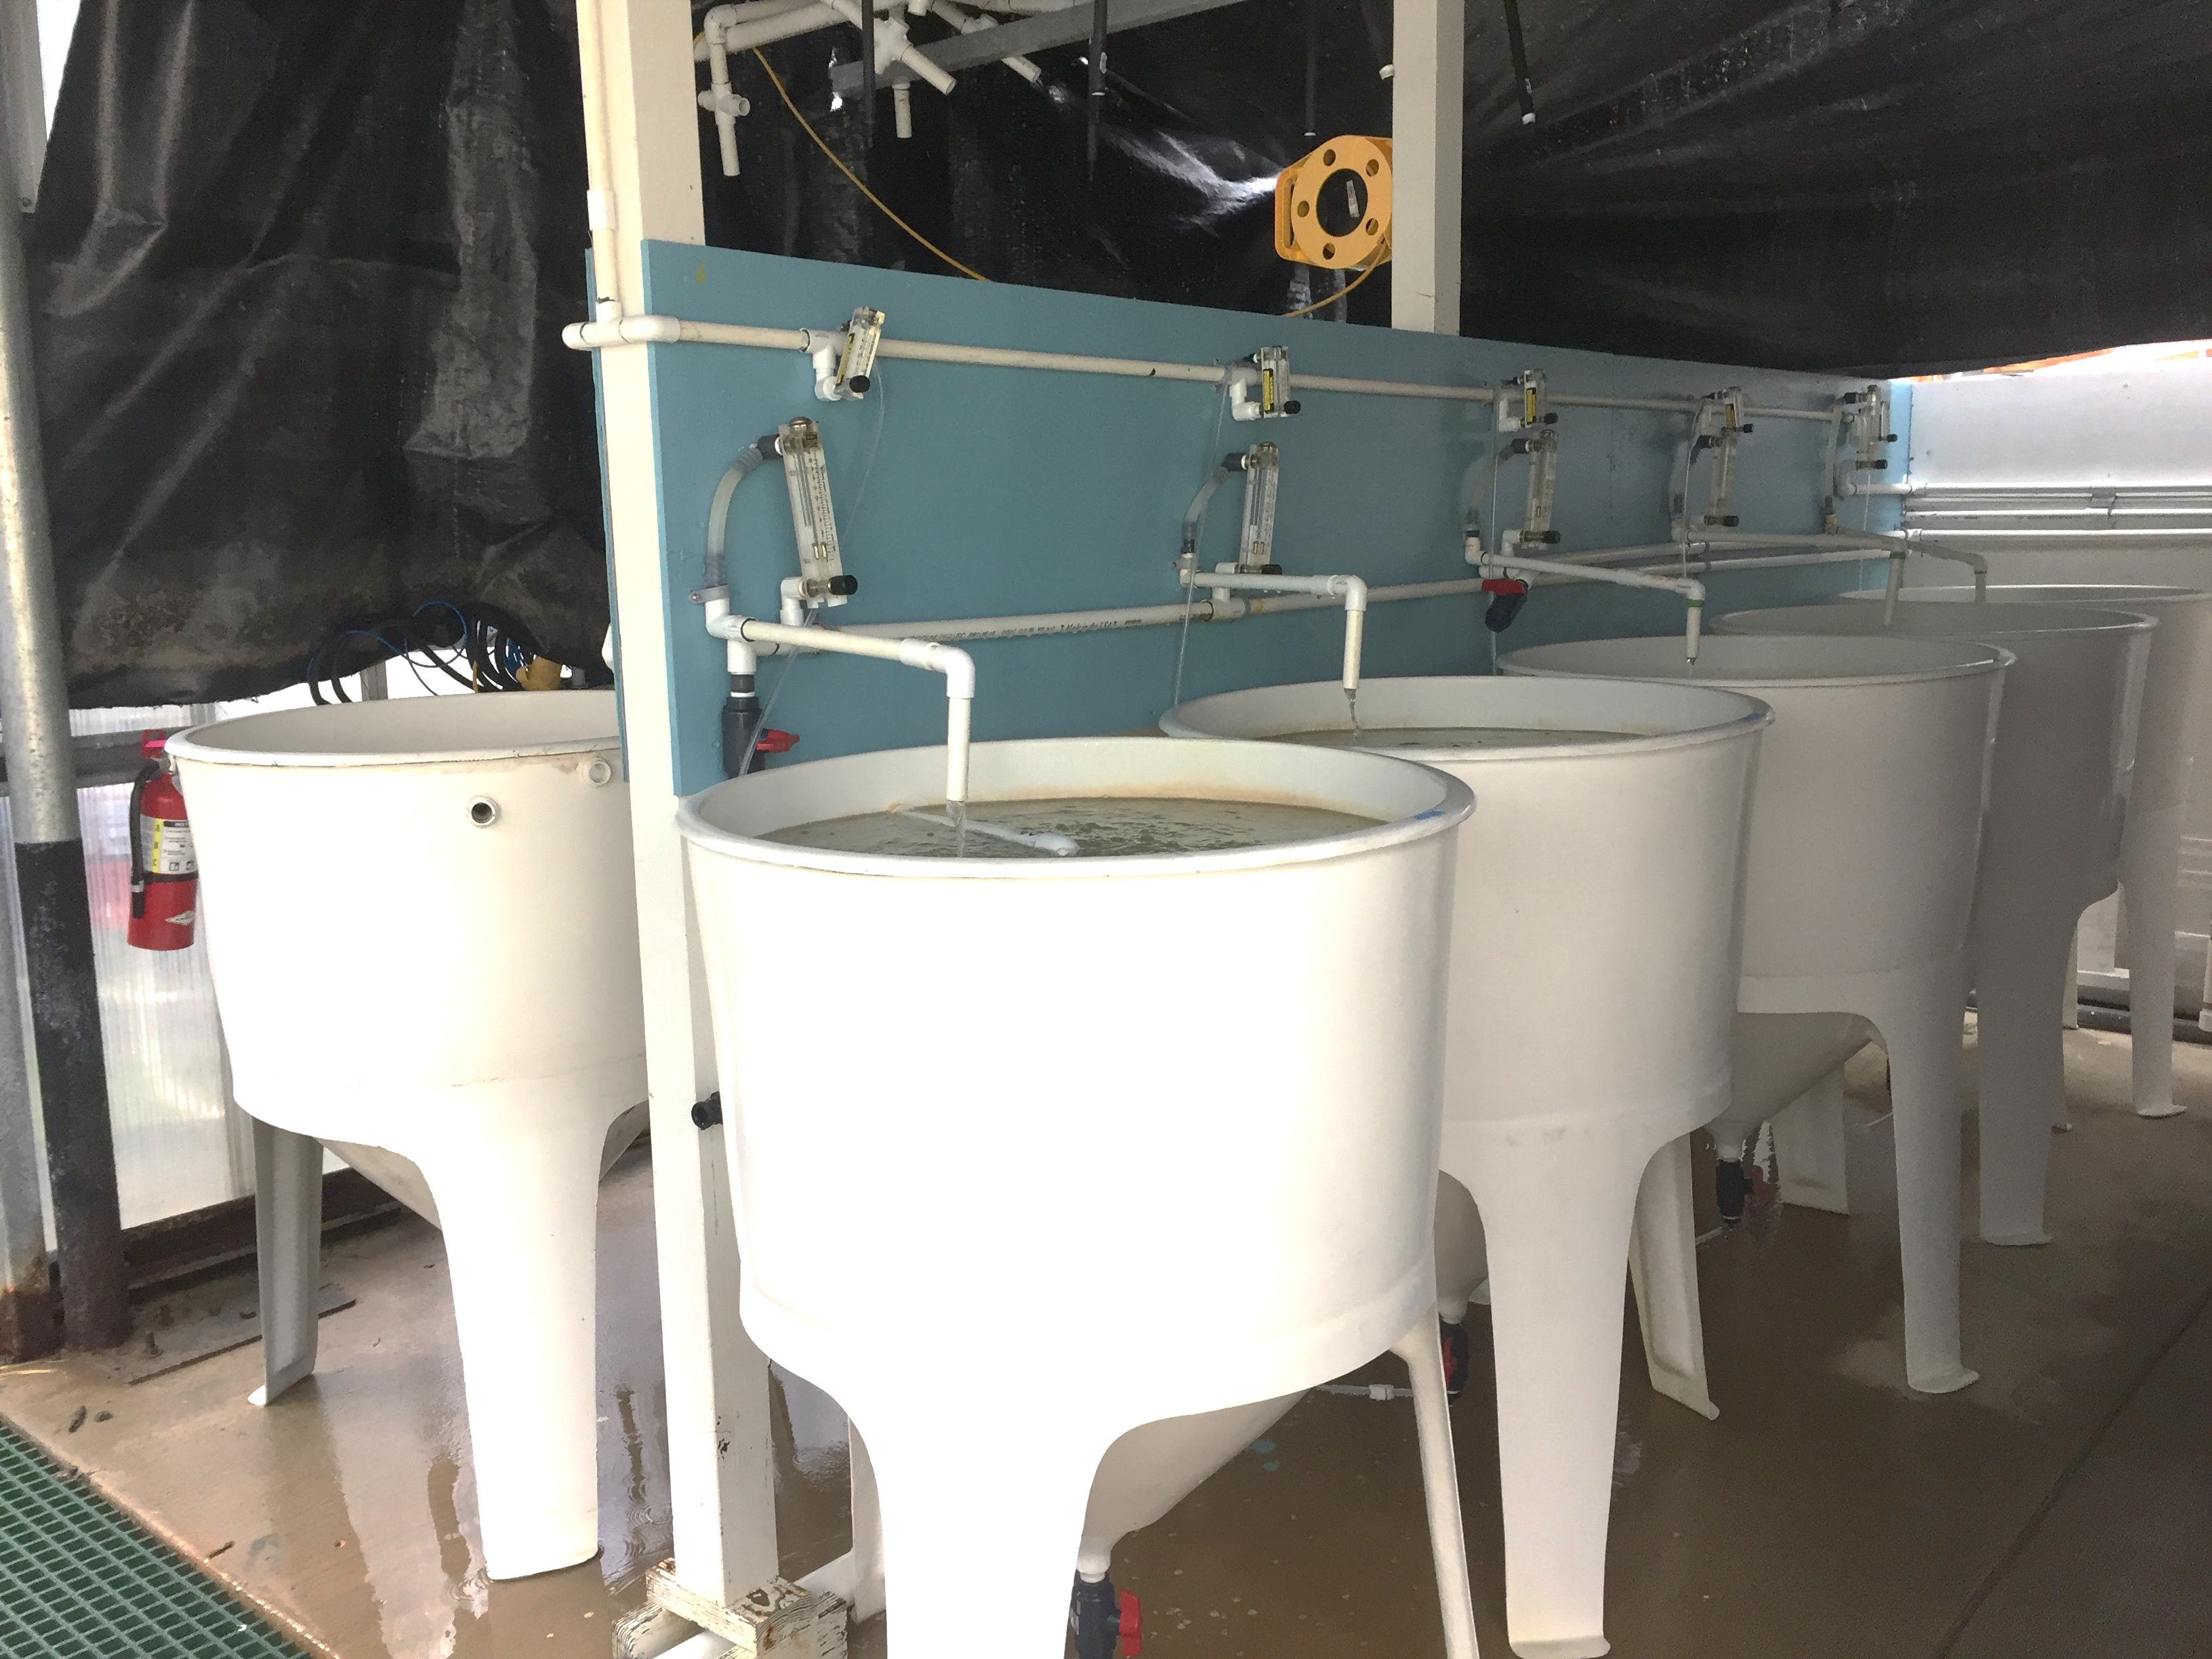
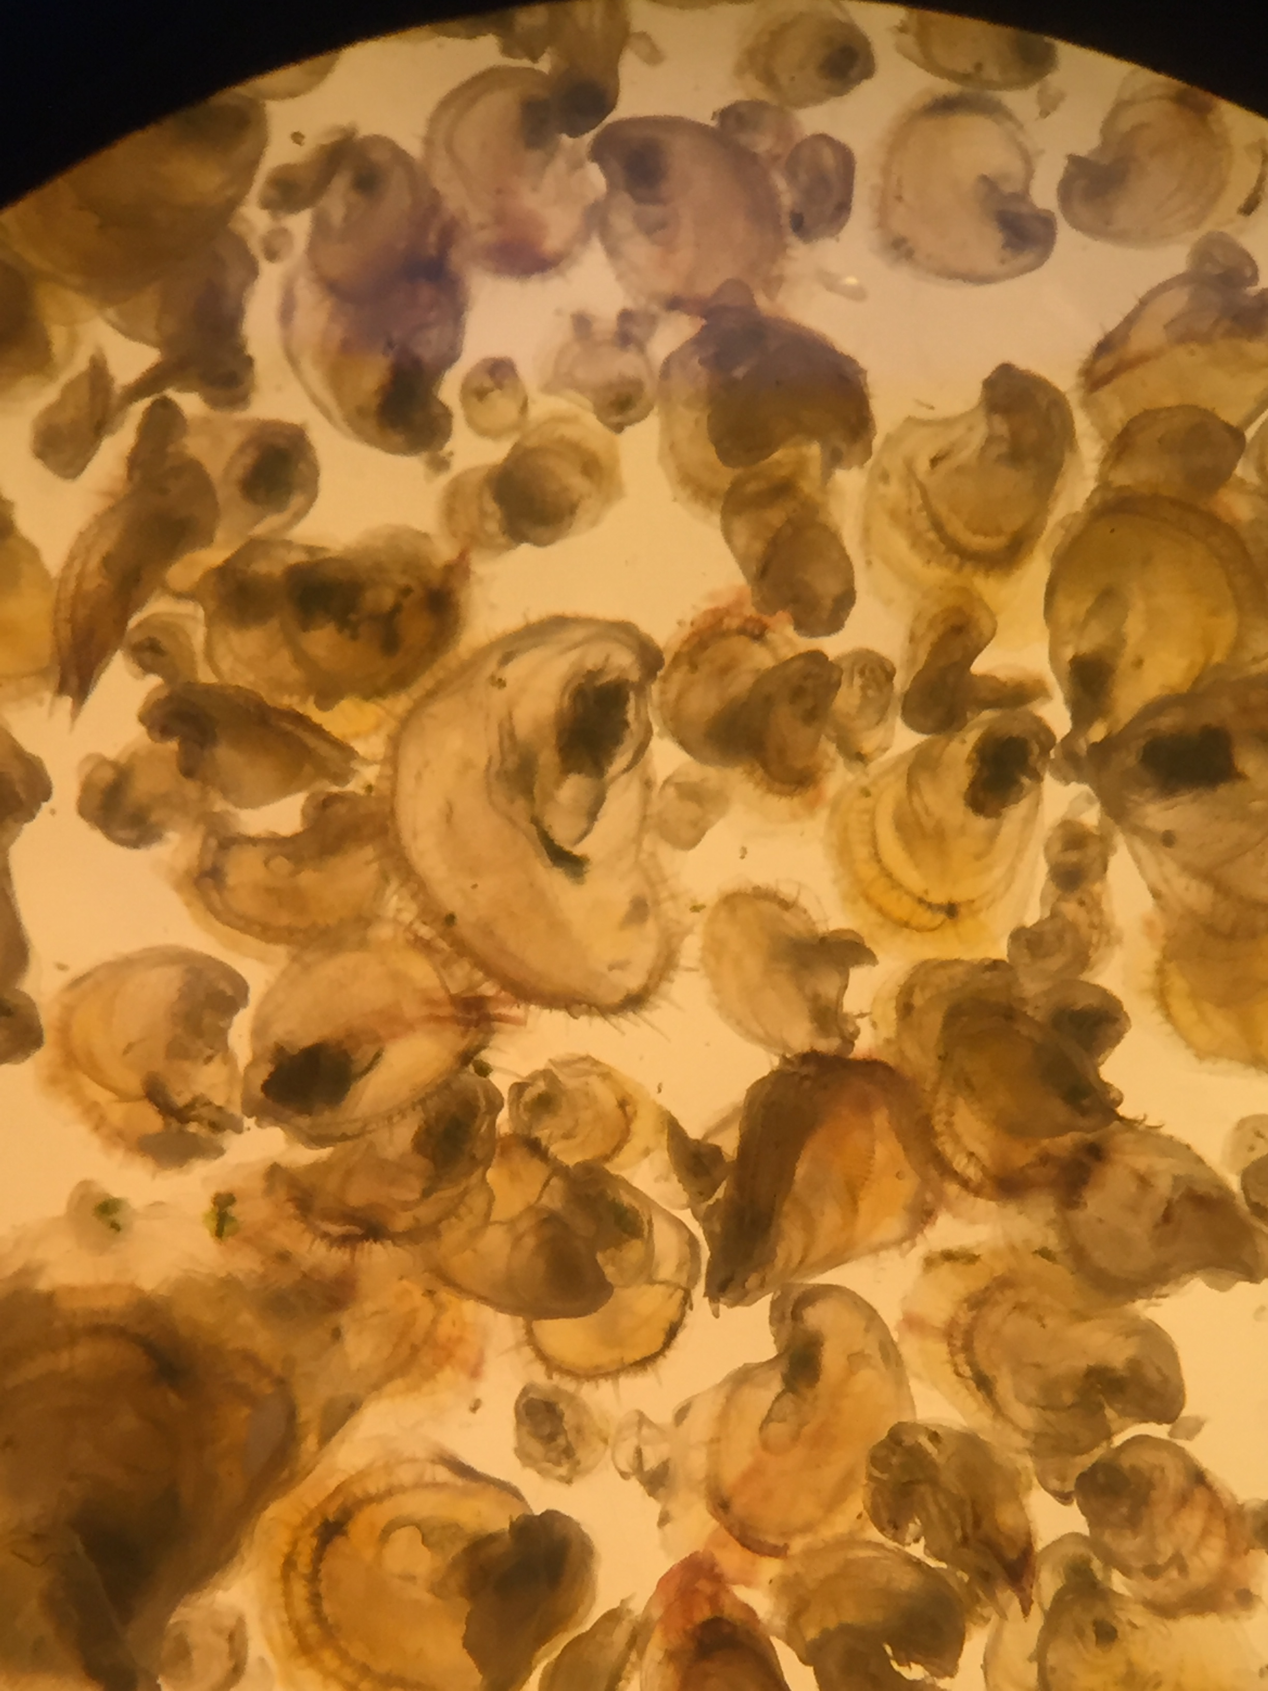
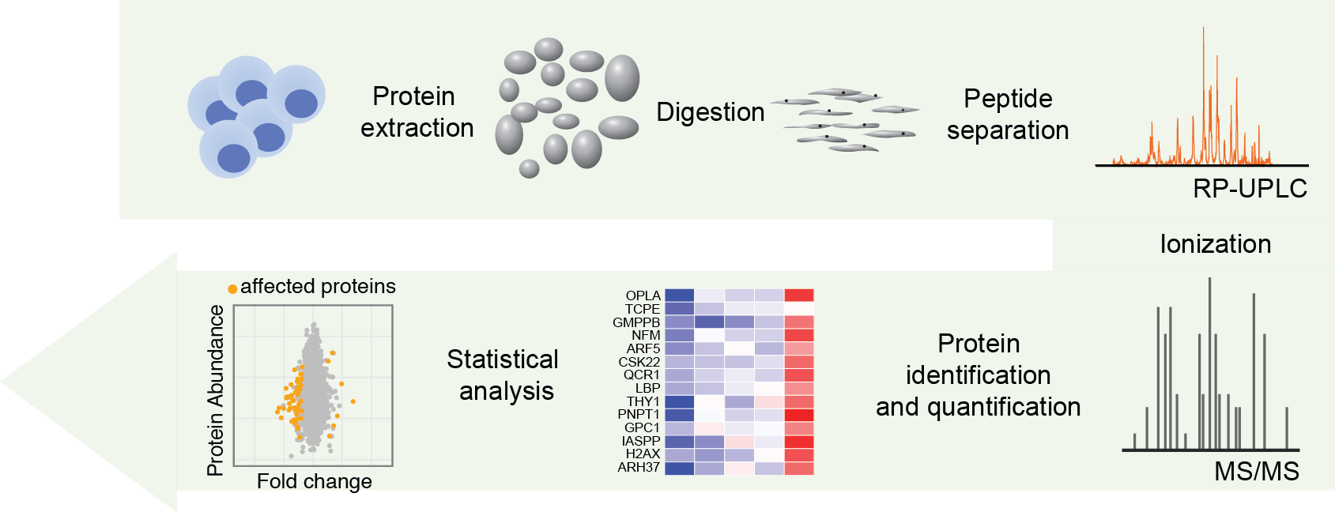
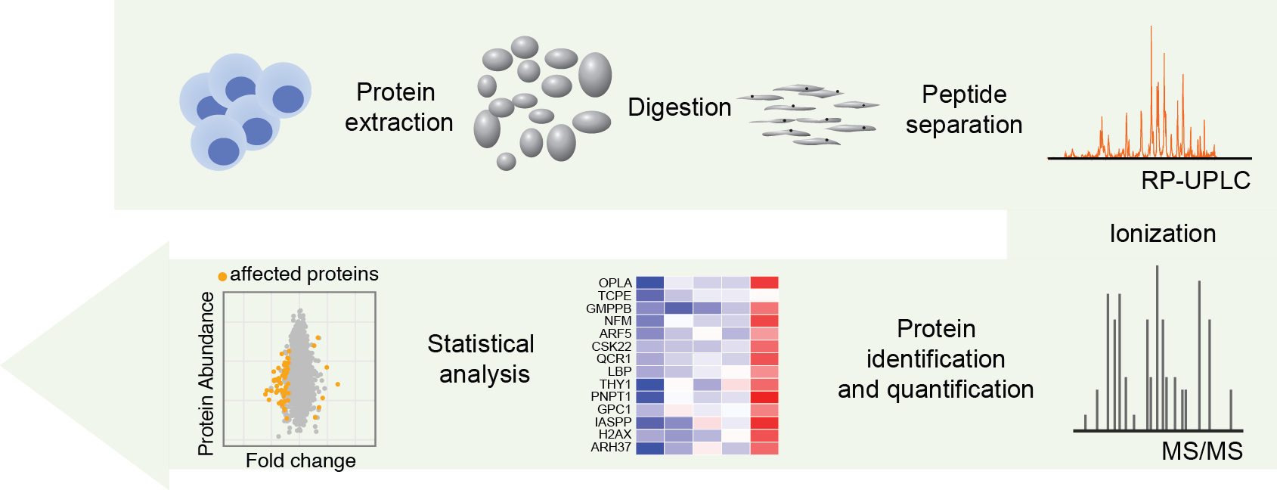
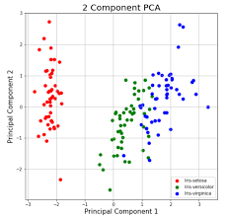
Temperature-influenced protein network differences in the Pacific oyster (Crassostrea gigas) during larval development
Roberts Lab
Shelly A. Trigg¹, Kaitlyn R. Mitchell¹, Rhonda Elliot¹, Emma Timmins-Schiffman², and Steven B. Roberts¹
¹School of Aquatic and Fishery Sciences, University of Washington, Seattle, Washington, USA
²Taylor Shellfish Hatchery, Taylor Shellfish Company, Quilcene, Washington, USA
³Department of Genome Sciences, University of Washington, Seattle, Washington, USA
Scan here to:
see animated network gif
see Github repository
see poster on figshare
give poster feedback
BACKGROUND
RESULTS
Pacific oyster is an economically and ecologically important species distributed along the North American Pacific Coast.
Larval sensitivity to environmental conditions can lead to mass mortality, and negative impacts on industry and ecosystems
Past experiments have shown reduced mass mortality in larvae reared in 27°C-29°C compared to 23°C seawater^{1,2}, but the the biological processes underlying this are not clear.
It is not known how the landscape protein expression changes during larval development or how temperature affects it.
Proteomics can be used to characterize biological processes potentially affected by temperature^{4,5}.
Higher temperature gives rise to larger animals
Proteomics detects 11288 proteins in oyster larvae
PCAs show separation of temperature conditions and developmental time points
: temperature
: time
Oysters as Biofilters
After 6 days of temperature conditioning, there were no differences in survival between 23°C and 29°C, but animals reared at 29°C measured larger than those reared at 23°C.
Across all time points, 6859 and 6720 proteins were detected in 23°C and 29°C treated larvae pool samples, respectively.
PCAs derived from ANOVA-simultanteous component analysis show that samples separate into groups for temperature and time submodels. 100% variation can be explained by PC1 in the temperature sub-model, so PC1 loadings values were used to assign initial ranks to proteins.
Cr: Drawnbydawn
153 proteins showed a significant difference (FDR-corrected P value < 0.1) in abundance between temperatures at given time point by a Chi-square proportions test. Collectively, ASCA ranked proteins (PC1 loadings value cutoff > 0.025) and proportions test identified 263 proteins of which 132 mapped to Uniprot accessions at an e-value cutoff of 10e-10. Because proteins mapped to multiple species, we looked to GO annotations from Uniprot to explore relationships among proteins rather than physical protein interactions.
EXPERIMENTAL METHODS
Pipeline for exploring protein relationships through shared GO terms
STEP 1:
Selected protein → GO term → GO slim
STEP 2:
Find relationships between protein GO slim associations
A relationship was defined by a GO semantic similarity score of 0.5
STEP 3:
Incorporate protein abundance change data into each GO slim
log fold-change in abundance between 23°C and 29°C was calculated for each sampling time point
For each GO slim, magnitude fold-change was summed then divided by the number of proteins associated with the term
STEP 4:
Identify temperature-induced network changes
Temperature-influenced network differences
Summary of experimental procedures. A) 1 M larvae from Puget Sound were reared in a hatchery setting in 200-L tanks with flowing filtered seawater at either 23°C or 29°C for 13 days. B) Pooled samples (~25 larvae/pool) were collected every other day for a total of 6 time points and flash frozen at -80C for proteomics analysis. C) Proteomics workflow; LC-MS/MS data-dependent acquisition was performed at the University of Washington Proteomics Resource.
DAY 3
DEVELOPMENT
METABOLISM
TRANSPORT
Node Color
relative log fold-change magnitude
Temperature-influenced protein-GO network differences. Nodes are GO slim terms colored by the total magnitude log2 fold-change of all their associated significantly altered proteins in 29°C vs. 23°C, relative to the number of proteins associated with the GO slim term. Node size and text are relative to the log fold-change magnitude. Days 3, 11, and 13 are shown because these days showed the most change. Development, metabolism, and transport networks are highlighted in blue, green, and purple, respectively.
A
B
29°C
23°C
DAY 11
DEVELOPMENT
METABOLISM
TRANSPORT
DISCUSSION
In oyster larvae reared at higher temperature:
alterations in ribosome biogenesis, protein maturation, amino acid metabolism, and decreased cell death associated protein abundance occur in early development
alterations in DNA and lipid metabolic processes, mRNA processing, nuclease and transferase activity, and cytoskeleton-dependent transport occur in late development
increases in larvae size can be attributed the alterations of these processes during specific developmental time points
While no difference in survival was observed in animals conditioned for 6 days at 23°C and 29°C:
biological processes molecular functions altered in larvae reared at a higher temperature may render the animals less susceptible to mass-mortality events.
altered processes under higher rearing temperature may override and/or prevent other processes that get tripped off in normal rearing conditions
C
Liquid chromatography
1
2
3
4
5
6
Protein identification and quantification
Statistical analyses
DAY 13
DEVELOPMENT
METABOLISM
TRANSPORT
Adapted from Kirkpatrick, Guhrs, Doring, Ohndorf, di Sanzo, and Ori (2016) Identification and Quantification of Proteins Using Mass Spectrometry. Core Facility Proteomics, Leibniz Institute on Aging.
ACKNOWLEDGEMENTS AND REFERENCES
ACKNOWLEDGEMENTS
Thank you to the current and former members of the Roberts lab at the University of Washington, the UW Proteomics Resource, and Taylor Shellfish Hatchery. This work is supported by Washington Sea Grant award NA14OAR4170078; Project R/SFA-8.
Fisheries of the United States 2017. National Marine Fisheries Service, National Oceanic and Atmospheric Administration (2018).
Kheder and Robert, Aquaculture 309, 286-289 (2010).
Rico Villa B., Pouvreau S., and Rene R., Aquaculture 287, 395-401 (2009).
Lopez, CE et al. Biology Open 6, 943-955 (2017).
Timmins-Schiffman E, Nunn BL, Goodlett DR, and Roberts SB. Conservation phys. (2013).

